Slide 1
IT & OT
OT
IT
Modbus
Storage
Devices
HMU
ERP
Edge / IoT
PLC
Cloud
SCADA
Security
Data
SQL
Machinery
HTTP
Figure 5.1 – IT and OT convergence facilitated by edge computing

Slide 2
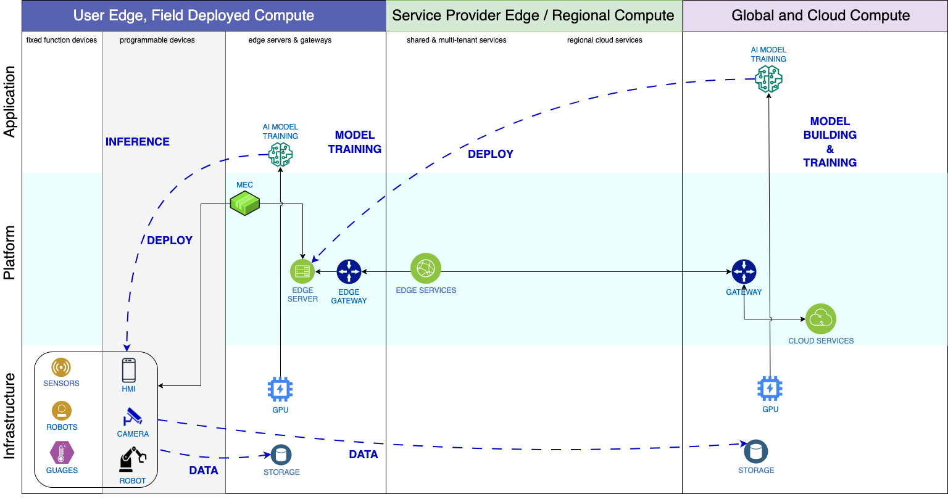
AI
Figure 5.2 – AI model life cycle in edge computing

Slide 3
Edge Controller
Edge Applications
Control Logic Engine
Containers (Docker)
Operating System (Linux)
RTOS
Real-Time Hypervisor
Computing Hardware
Figure 5.3 – Example edge controller augmenting PLC system

Slide 4







Network Slicing
Internet, Entertainment
Slice 1
Mobile Broadband
Physical 5G Network Infrastructure
Retail, Manufacturing
Slice 3
Massive IoT
Automotive, Medical
Slice 2
Mission Critical
Other Apps
Slice 4
Other
Services Layer
Network Slice Layer
Resource Layer
Figure 5.5 – 5G network slicing

